Slide 1






Attendance Recognition System using Half Face Appearance
Project Mentor : Ms. Mannat Doultani
Group No : 4
Members :
Yogesh Tekwani { Group Leader }
Sagar Sidhwa
Somesh Tiwari

Slide 2
Contents
Introduction to Project
Lacuna in the existing systems
Problem Definition
Literature Survey
Methodology employed
Hardware, Software, tools and the constraints
Block Diagram
Modular Diagram
Next Work Plan
Conclusion
References

Slide 3
Introduction to Project
Automatic face recognition technologies have made immense improvements in the changing world. The task of the proposed system is to capture the face of each student and to store it in the database for their attendance.
There is no need for the teacher to manually take attendance in the class because the system is provided with the image/Video by the teacher and through further processing steps the faces are being recognized and the attendance database is updated accordingly.
It helps in increasing the accuracy to ultimately achieve High-Precision Real-Time attendance to meet the need for Automatic classroom evaluation.

Slide 4
Lacuna in the existing system
Real-Time Authentication is completely dependent on Manual process.
Inconsistency in data entry, room for errors, miskeying information.
Time consuming and costly to produce reports.
Lack of security.
No Transparency

Slide 5


Problem Definition
This project aims to capture the Photo or Video of the students, convert it into frames, relate it with the database to ensure their presence or absence, mark attendance for the particular student to maintain the record.

Slide 6
Applications
Since, the base model is in working condition, we have received many useful suggestions to build multiple UIs for attendance in
Gyms
Classrooms
Playschools
Security Alarms
ATMs
Seminar Halls
CCTV Footage Scanners

Slide 7
Literature Survey
K.Senthamil Selvi, P.Chitrakala, A.Antony Jenitha, “Face recognition based Attendance marking system” IJCSMC, Vol. 3, Issue. 2, February 2014, pg.337 – 342
Mr.C.S.Patil, Mr.R.R.Karhe, Mr.M.D.Jain, “Student Attendance Recording System Using Face Recognition with GSM Based” International Journal of Research in Advent Technology, Vol.2, No.8, August 2014 E-ISSN: 2321-9637
Mathana Gopala Krishnan, Balaji, Shyam Babu, “Implementation of Automated Attendance System using Face Recognition” International Journal of Scientific & Engineering Research, Volume 6, Issue 3, March-2015

Slide 8







Methodology
Employed

Slide 9
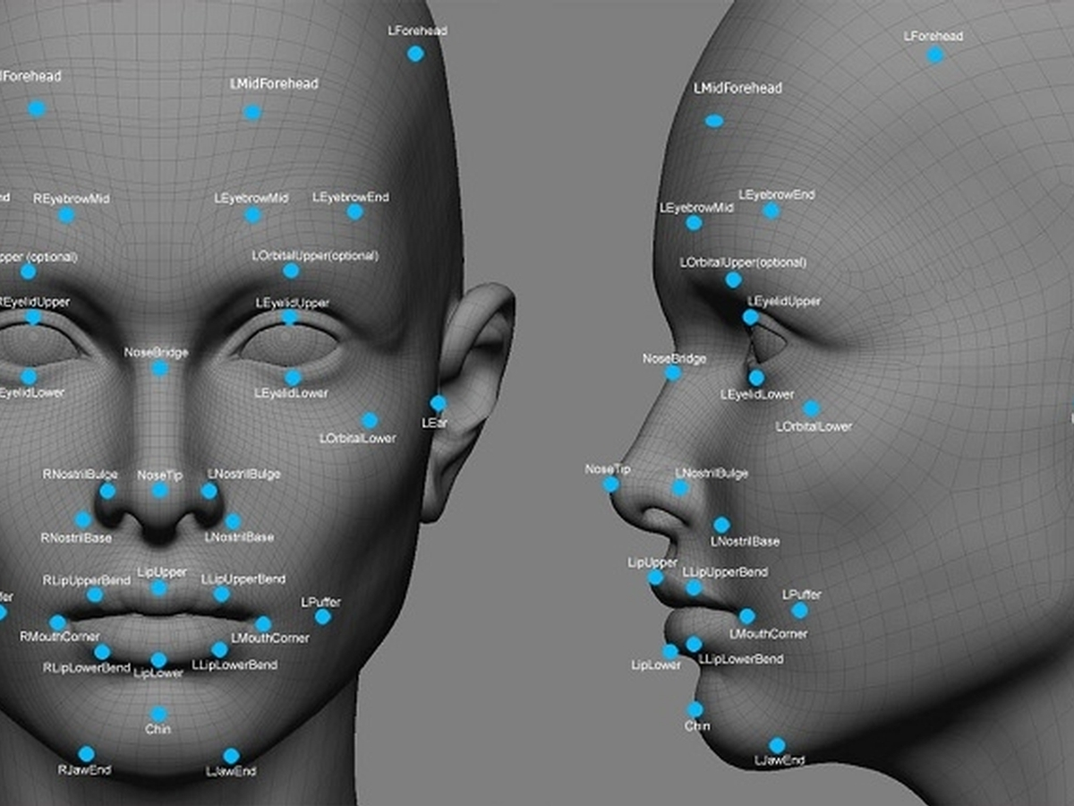
The proposed system is primarily based on the Capturing Points of the faces.
Firstly, it does the extractions of some facial features of the known images.
Secondly, it does the extraction of facial features of the captured images.

Slide 10
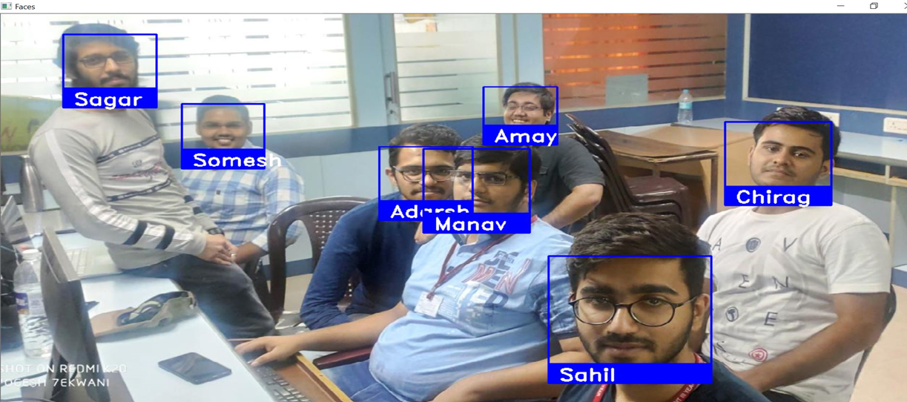
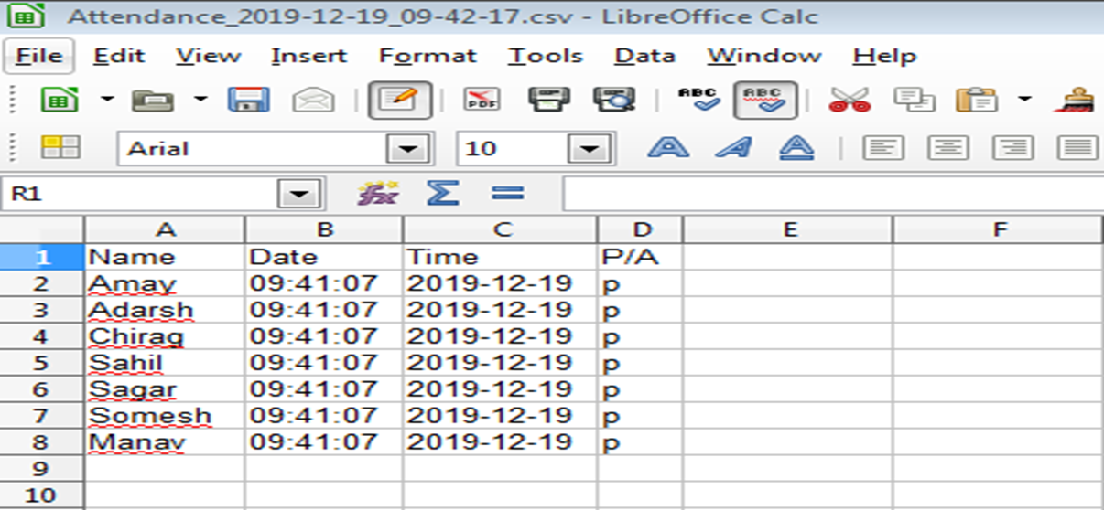
Third is to comparing the known with the unknown.
Fourth is, if match is found then Face Recognition is done.
Finally the attendance is marked in Auto-Generated Excel sheet.
Sample Output : Attendance of all 7 students is marked in Excel sheet.

Slide 11
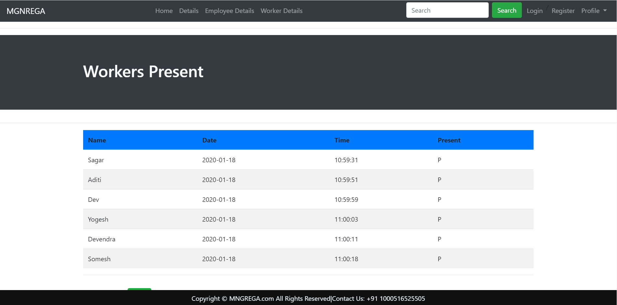

Slide 12
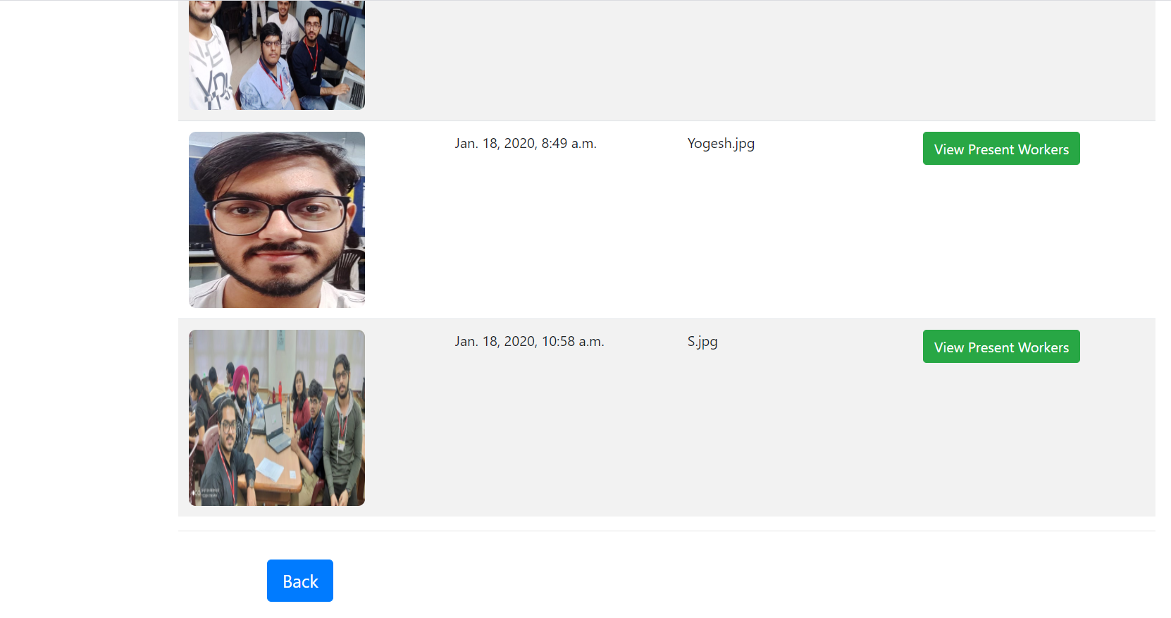

Slide 13
Hardware, Software, Tools and Constraints
Software Used:
Anaconda
Dlib
Visual Studio
Tools :
Cmake
VC++
Windows 10 SDK
OpenCV
Constraints:
Good Quality Camera.
Continuous Network Connectivity Required.
Faces should be properly visible to the Camera .
Processor requirement varies according to the size of the Database.
Camera Accessibility

Slide 14
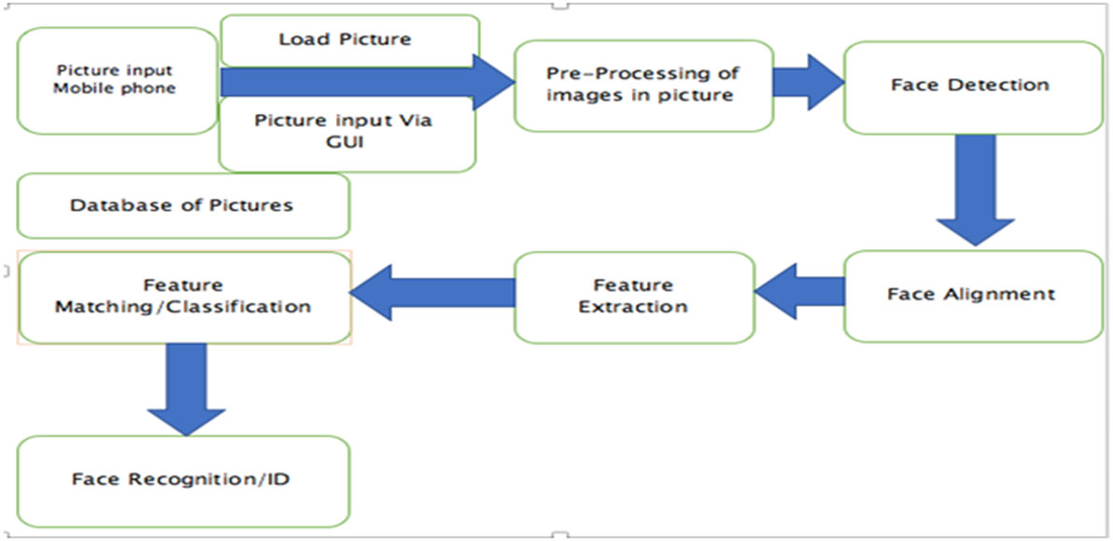
Block Diagram

Slide 15
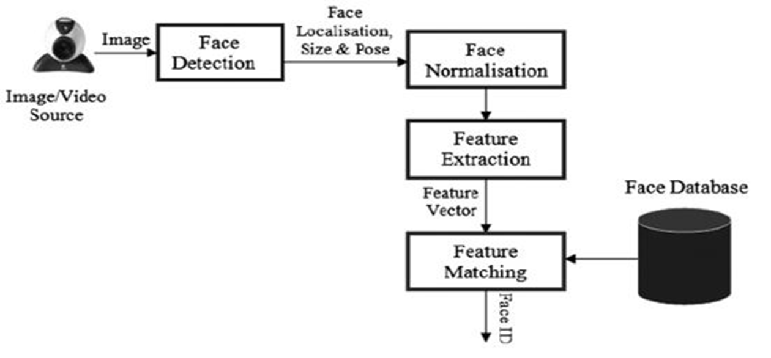
Modular

Slide 16
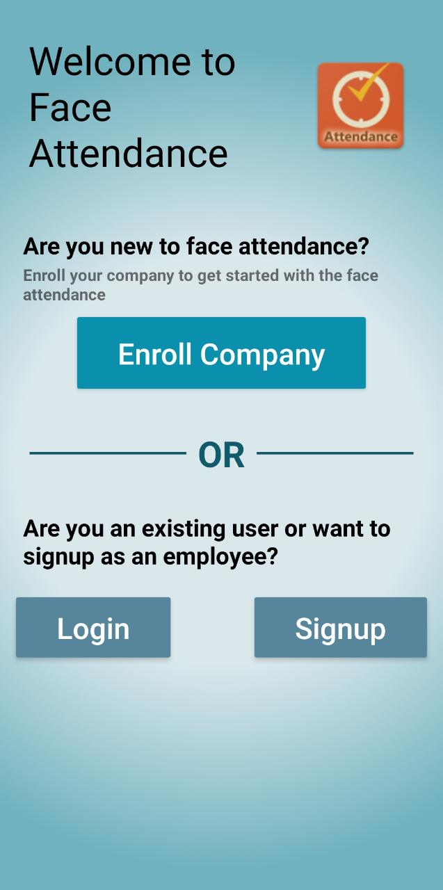
Next Work Plan
Mobile App based.
Photo/Video will be taken and live attendance will be marked in the Firebase.
‹#›

Slide 17
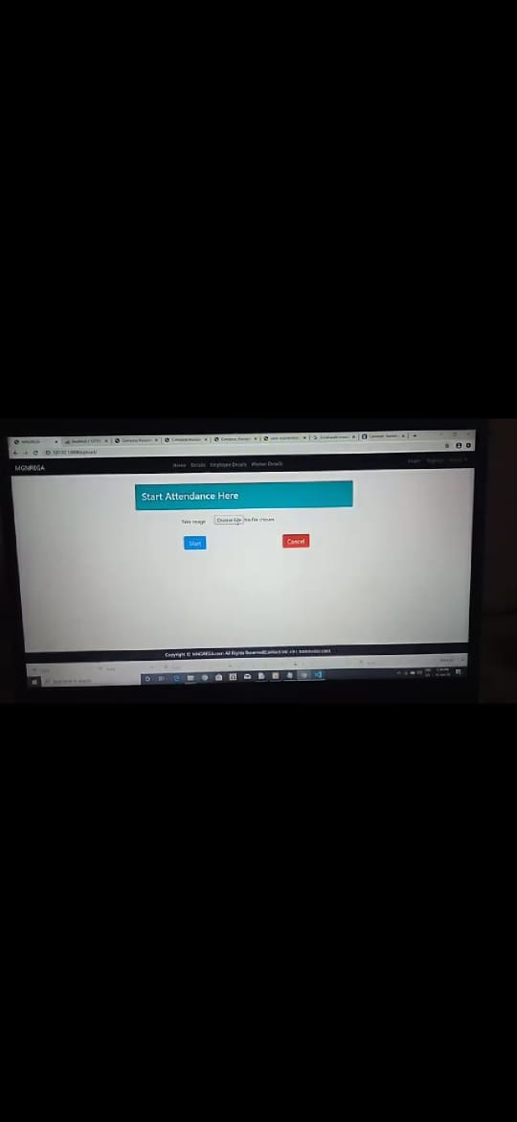
Next Work Plan
Web Application
based.
Place your screenshot here
‹#›

Slide 20
Conclusion
Thus, our solution for Intelligent Attendance successfully minimizes Human-Interference, Enhances transparency and completely eliminates the Gaps of the current system.
The Automation helps in eliminating the Fraudulent entries and ultimately achieve the High-precision, Real-Time attendance to meet the need for Automatic and Reliable evaluation.

Slide 21
REFERENCES
K.Senthamil Selvi, P.Chitrakala, A.Antony Jenitha, “Face recognition based Attendance marking system” IJCSMC, Vol. 3, Issue. 2, February 2014, pg.337 – 342
Mr.C.S.Patil, Mr.R.R.Karhe, Mr.M.D.Jain, “Student Attendance Recording System Using Face Recognition with GSM Based” International Journal of Research in Advent Technology, Vol.2, No.8, August 2014 E-ISSN: 2321-9637
Mathana Gopala Krishnan, Balaji, Shyam Babu, “Implementation of Automated Attendance System using Face Recognition” International Journal of Scientific & Engineering Research, Volume 6, Issue 3, March-2015

Slide 22

Thank You !
Any questions?

